Slide 1
Capstone project Business opportunity
What and where
Elias Adame

Slide 2
What business is the most popular in most cities?
We analyzed select US Cities and discovered that Fast Food Restaurants are the most popular
Out of 92 Cities:
33 rank Fast Food Restaurant in their Top 10 Most Popular Venues
9 rank Fast Food Restaurant as their # 1 Most Popular

Slide 3
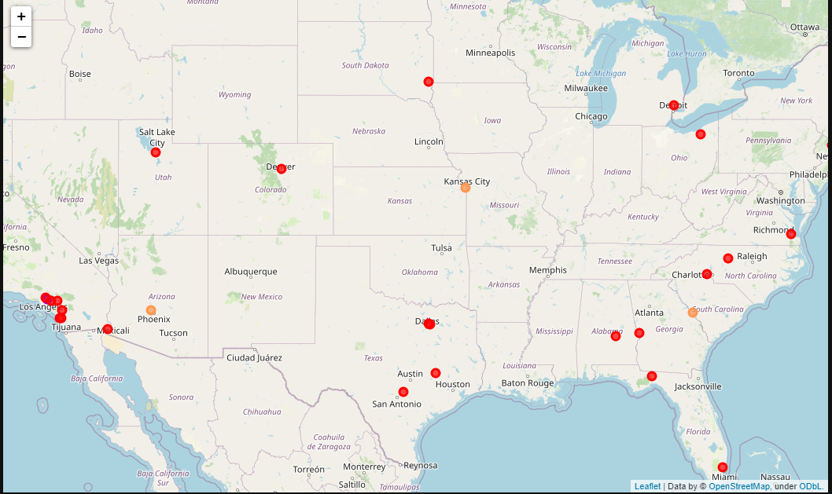
Cities with fast food in top 10

Slide 4
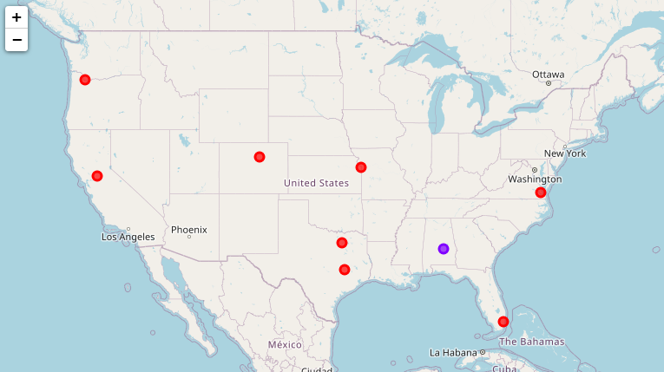
Cities with FAST FOOD AS # 10
College Station
Elk Grove
Garland
Kansas City
Miami Gardens
Montgomery
Newport News
Thonrton
Vancouver

Slide 5
Clustering cities
We cluster cities based on similarity of popular venues
We get cities with Fast Food as # 10 that are in the same cluster as cities with it at # 1
This reduces the number of possible cities to:
College Station
Thornton
Kansas City
Newport News
Vancouver
Montgomery

Slide 6
Choosing the winning city
Finally, we analyze the last 6 possible cities to decide on a final one
When looking at these cities Top 10 Venues, we identified that five of these cities had Venues that are Fast Food competition in their Top 5 Venues.
Thus, we choose Montgomery, AL as the most suitable city for a new business venture with the most growth potential

